Slide 1
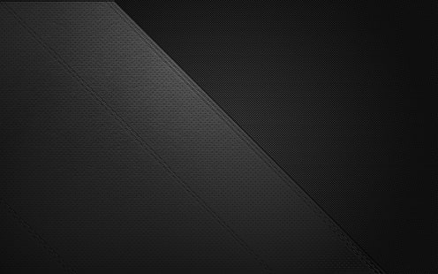
Russian number plate reader
Made by Varga Szabolcs

Slide 2


Slide 3
OpenCV
Numpy
Haarcascade

Slide 4
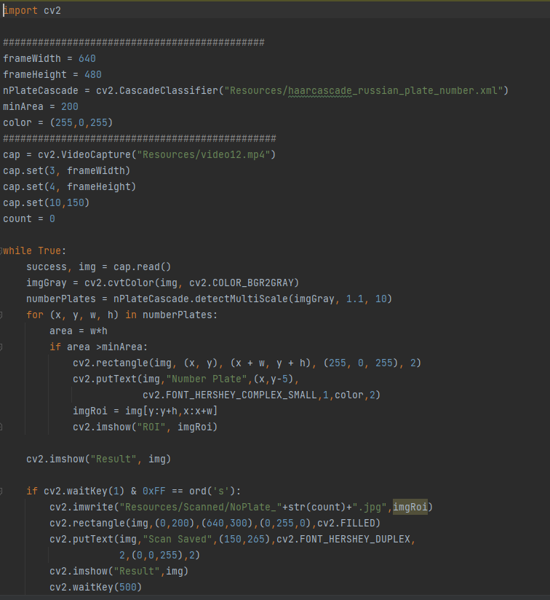

Slide 5
Img

Slide 6
Why is it useful?
Every car can be tracked
Useful on crowded roads
Can identify number plates real time

Slide 7
Thank you for your attention!

